Slide 1
PERSONAL DATA AND PRIVACY IN A NETWORKED WORLD
March 25, 2024
Keith Burghardt

Slide 2
“We’ve lost control of our personal data”
“The current business model for many websites offers free content in exchange for personal data. Many of us agree to this – albeit often by accepting long and confusing terms and conditions documents – but fundamentally we do not mind some information being collected in exchange for free services. But, we’re missing a trick. As our data is then held in proprietary silos, out of sight to us, we lose out on the benefits we could realise if we had direct control over this data, and choose when and with whom to share it. What’s more, we often do not have any way of feeding back to companies what data we’d rather not share – especially with third parties – the T&Cs are all or nothing...”
-- Sir Tim Berners-Lee in “Three challenges for the web, according to its inventor,” March 12, 2017

Slide 3
Keeping up with privacy policies
“only members of groups you
belong to”*
2005
2006
“your school, your specified local area”*
“networks you allow…
(e.g., school,…, friends of friends)”*
2007
2008
friends list is public by default, list of Pages you like has to be public
certain default privacy
settings to Everyone, “subject to indexing by third party search engines… may be imported and exported by us and others without… limitations“*
2009
applications you connect to
have access to “your and friends’ names, profile pictures, gender, connections, and any content shared” with Everyone*
2010
...
*https://www.eff.org/deeplinks/2010/04/facebook-timeline
Notes:
Two aspects: default privacy settings and privacy policy
2005 – only members of groups you belong to
2006 – “your school, your specified local area, and other reasonable community limitations”
2007 – “at least one of the networks you allow […] (e.g., school, geography, friends of friends)”
2008 – friends list is public by default, can be made private; list of Pages you like is public
2009 - “The default privacy setting for certain types of information you post on Facebook is set to “everyone.” “Information set to “everyone” […] is subject to indexing by third party search engines, may be associated with you outside of Facebook (such as when you visit other sites on the internet), and may be imported and exported by us and others without privacy limitations.”
2010 – “When you connect with an application or website it will have access to […] your and your friends’ names, profile pictures, gender, user IDs, connections, and any content shared using the Everyone privacy setting.” “The default privacy setting for certain types of information you post on Facebook is set to “everyone.”
“your privacy settings only control who can see the connection on your profile page” (warning that you cannot control your friend’s privacy settings)
2011 – you can make categories of Likes as private

Slide 4
Personal information in social media
People reveal private information online
Your online profile
Birthdate, home town, education, religion, marital status
Your Likes and tastes
Favorite tv shows, movies, music, food
Your status updates
People reveal private information through their social connections
The friends who may reveal private information
The groups people join

Slide 5
Privacy in social networks
Beyond identity and attribute disclosure
Link re-identification [Zheleva & Getoor ’07] (link prediction can reveal sensitive links)
Anonymization by removing the profile attributes not enough
Structural re-identification [Backstrom et al. ‘07]
Structural anonymization [Hay et al. ’08]
Re-identification across networks [Narayanan & Shmatikov ’09]
Differentially-private analysis of graphs
[Task & Clifton‘14, Raskhodnikova & Smith‘15]
Privacy in Social Networks. E. Zheleva, E. Terzi, L. Getoor. Morgan & Claypool Publishers 2012.
Notes:
Some of the first work on privacy in online social networks started coming out about ten years ago.
When people started paying attention
- Anonymization by removing Structural patterns unique

Slide 6
Privacy in social networks
Understanding privacy risks
Inferring information in social networks [Zheleva ’09]
Privacy scores [Liu & Terzi ‘10]
Information-sharing models [Kleinberg & Ligett ’10]
Re-identification through online activity [Kosinski et al, 2014]
Connecting privacy and fairness
FairTest: unwarranted associations framework [Tramer et al. ’17]
Unintentional vs Intentional decision making
Privacy in Social Networks. E. Zheleva, E. Terzi, L. Getoor. Morgan & Claypool Publishers 2012.
Notes:
Privacy score – quantification of privacy risk, Using this score, a user can monitor his/her privacy risk in real time and compare it with the rest of the population to see where he/she stands
formalize the tradeoff between the benefit of sharing and the risk of exposure
privacy wizards as mechanisms that use data-mining and machine-learning techniques as well as limited user input, in order to learn a privacy-preference model for each user.
unwarranted associations framework: a principled methodology for the discovery of unfair, discriminatory, or offensive user treatment in data-driven applications.

Slide 7
What is private information?
People may choose not to reveal certain pieces of information about their lives
Private information includes
Sexual orientation, age, income, …
Political affiliation
Intelligence
Personality
“the combination of characteristics or qualities that form an individual's distinctive character.”
This information might be predicted
From unrelated publicly disclosed information

Slide 8
Big 5 Personality Traits
Openness to Experience/Intellect
High scorers tend to be original, creative, curious, complex; Low scorers tend to be conventional, down to earth, narrow interests, uncreative.
Conscientiousness
High scorers tend to be reliable, well-organized, self-disciplined, careful; Low scorers tend to be disorganized, undependable, negligent.
Extraversion
High scorers tend to be sociable, friendly, fun loving, talkative; Low scorers tend to be introverted, reserved, inhibited, quiet.

Slide 9
Big 5 Personality Traits
Agreeableness
High scorers tend to be good natured, sympathetic, forgiving, courteous; Low scorers tend to be critical, rude, harsh, callous.
Neuroticism
High scorers tend to be nervous, high-strung, insecure, worrying; Low scorers tend to be calm, relaxed, secure, hardy.

Slide 10
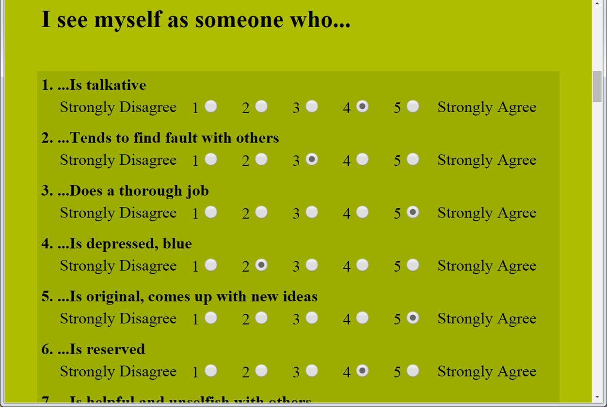
The Big 5 Personality Test
https://www.truity.com/test/big-five-personality-test

Slide 11
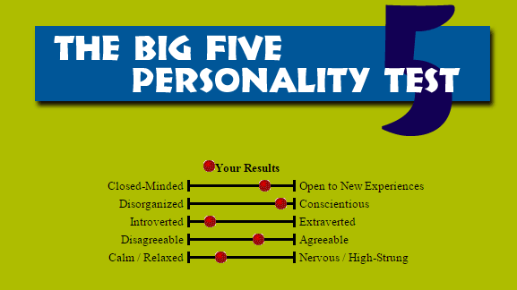
Big 5 Personality Traits
https://www.truity.com/test/big-five-personality-test

Slide 12
Predicting personality traits with social media
Can a user’s personality be predicted from his/her publicly available social media profile information?
Through self-description, status updates, interests etc. much of the user’s personality is reflected
This paper describes the type of data collected, their methods of analysis and the results of predicting personality traits through machine learning
Implications to social media design, interface design and other applications such as online marketing and advertising
Golbeck et al (2011) “Predicting Personality Traits with Social Media”, in CHI.

Slide 13
Data Collection
Created a Facebook application to administer “Big Five” personality survey to 279 users. Collected their profile statistics:
Structural Features
User’s ego-centric network size, density
Personal Information
user name
gender
birthday
relationship status
religion
education
hometown

Slide 14
Data Collection (cont.)
Activities and Preferences
lists of favorite, such as movies, music etc.
Language Features
This all the text that the users shared through
“About Me”, “blurb” text and status updates.
Of the 279 users, only 167 had enough words to be actually used in this data set.
Used LIWC to analyze the text producing statistics on 81 different features of text in the 5 categories.

Slide 15
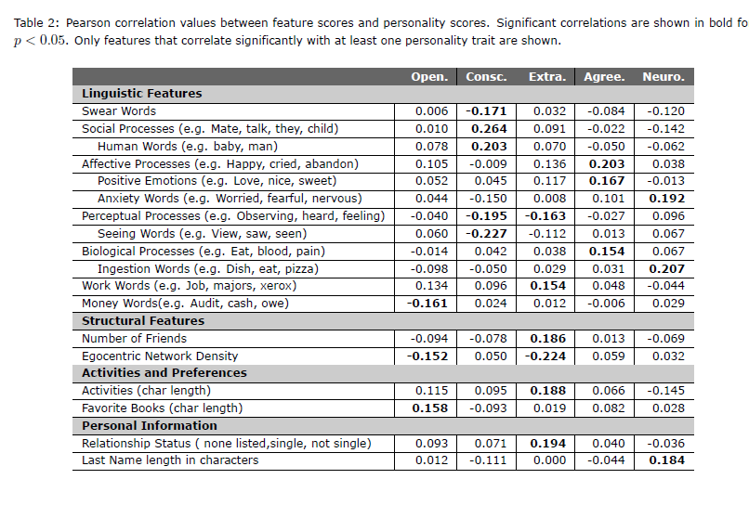
Personality-features correlation

Slide 16
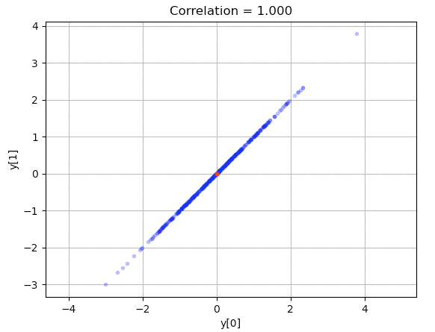
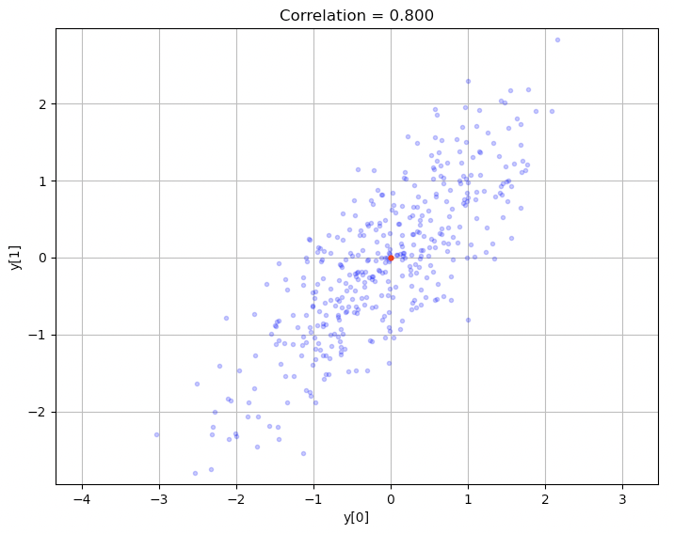
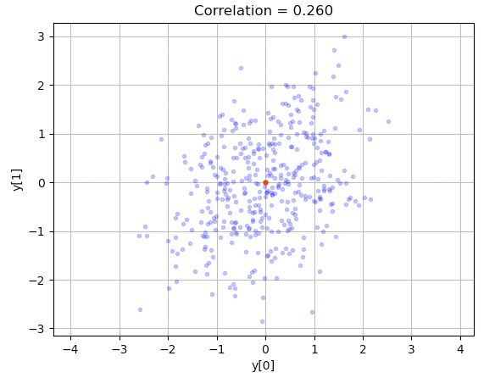
Correlation Reminder

Slide 17
Personality and Social Media Profile
Weak correlations between user’s profile and personality scores:
Conscientiousness
negatively correlated with the frequency of swear words as well as words that described perceptual processes.
positively correlated with words concerning social processes.
Agreeableness correlated positively with words describing feelings and
Neuroticism correlated positively with words describing anxiety
Length of the reported activities and interests correlated with extraversion and openness

Slide 18
Personality and Social Media Profile
Extroverts
Larger networks (more friends)
Less dense network structure.
Correlation between neuroticism and length of the user’s last name.
Woman were more conscientious, agreeable and neurotic than men.
Users who chose to share a URL to an external website were more open than those who didn’t.

Slide 19
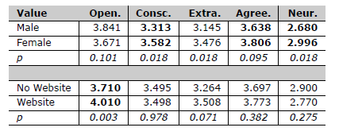
Differences between subpopulations
Notes:
Ratio between means

Slide 20
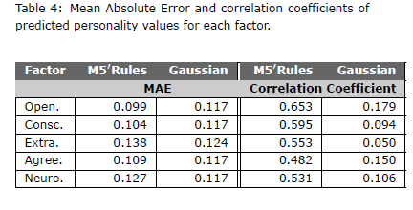
Predicting Personality
Predicted personality trait score based on 74 user features
using regression with 10-fold cross-validation
The Mean Absolute Prediction Error around 11%
Notes:
M5’Rules is a classifier; Gaussian processes

Slide 21
Predicting private traits from digital records of human behavior
[Kosinski, M., Stillwell, D., & Graepel, T. (2013). Private traits and attributes are predictable from digital records of human behavior. PNAS]
Facebook users employ ‘likes’ to express their positive attitudes towards online content and entities
Publicly available
Similar to Web search queries, Web browsing history, and credit card purchases.
Statistical method to automatically and accurately estimate personal attributes from Facebook ‘likes’

Slide 22
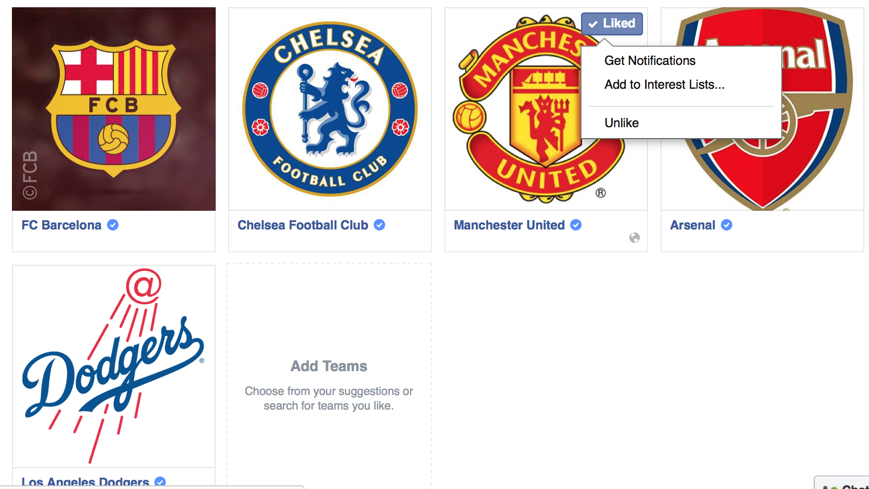
Simon’s Likes on Sports
What kinds of sports does Simon like?

Slide 23
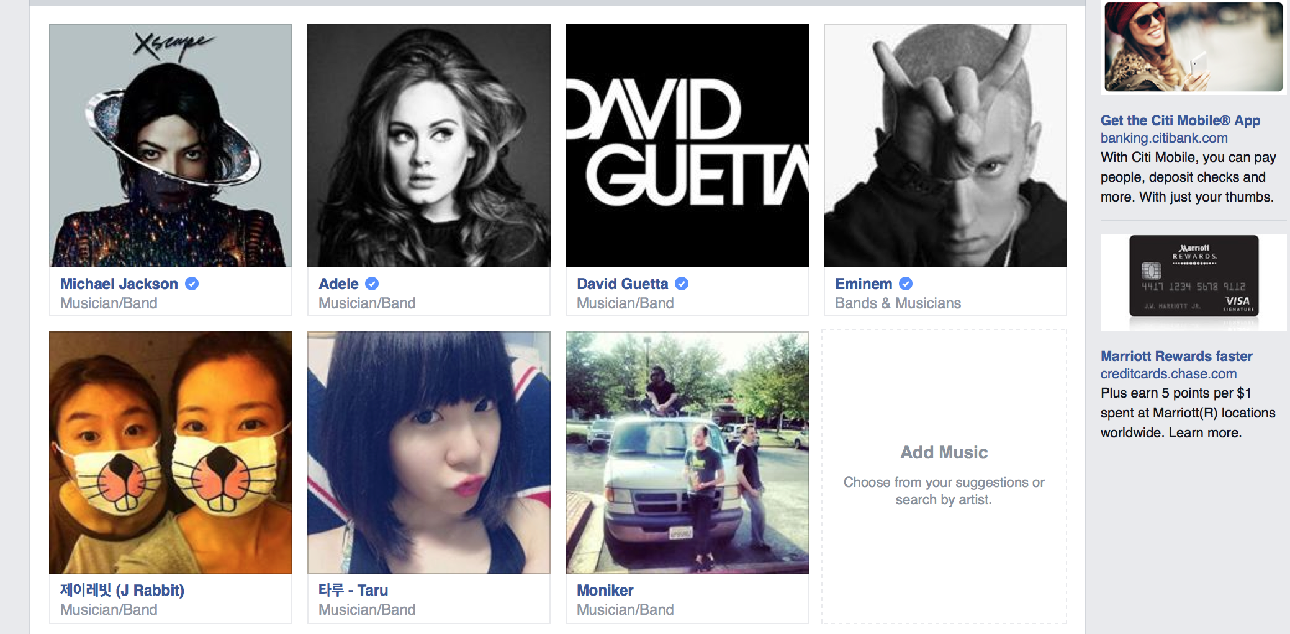
Simon’s Likes on Music
Can you guess Simon’s music tastes ?

Slide 24


Facebook Likes -> Personal Traits (Digital Fingerprinting)
Likes in Facebook can be used to automatically and accurately predict with high probability for the highly sensitive personal attributes such as
gender
ethnicity
religious
political views
personal traits
intelligence
happiness
Christian
Male
?
Democrat
Asian

Slide 25
Main Questions
Can we automatically estimate a wide range of personal attributes that people would typically consider to be private ?
Can we accurately estimate a wide range of personal attributes that people would typically assume to be private ?
Can we use only Facebook Likes ?

Slide 26
Design of User Study
Step1. Selected the private and intrusive attributes
sexual orientation, ethnicity, political views, religion
personality, intelligence, satisfaction with life (SWL), substance use (alcohol, drugs, cigarettes), whether an individual’s parents stayed together until the individual was 21 years old
basic demographic attributes such as age, gender, relationship status, and size and density of the friendship network
Notes:
They first analyzed the Likes data for individuals for Analysis
Then, they applied their prediction model for random individual and see how good their models are.

Slide 27
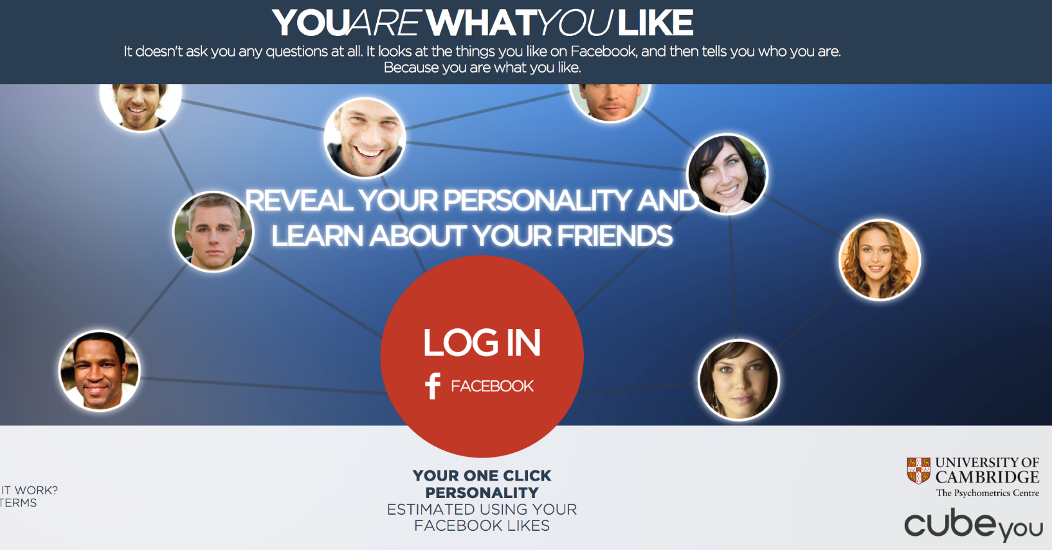
Design of User Study
Step2. Data Collection
They obtained data set from 58,000 volunteers who share their 10M Facebook Likes, profiles, and took psychometric surveys.

Slide 28
Methodology/Models
Truncated SVD for computation and data analysis
Used top 30~100 SVD components, depending on the attributes.
Logistic/linear regression model for Prediction
Gender = α_{Gender} + β₁C₁+β₂C₂+…+β_{i}C_{i}+…β₃₀C₃₀
Age = α_{Age} + β₁C₁+β₂C₂+…+β_{i}C_{i}+…β₁₀₀C₁₀₀
Evaluations
Pearson product–moment correlation coefficient between the actual and predicted values to measure the accuracy of prediction.
Notes:
They first analyzed the Likes data for individuals for Analysis
Then, they applied their prediction model for random individual and see how good their models are.

Slide 29
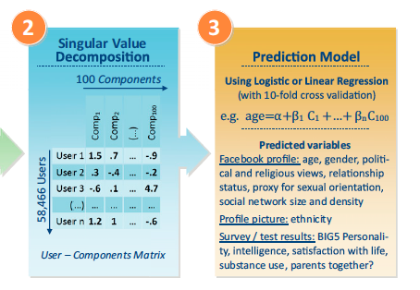
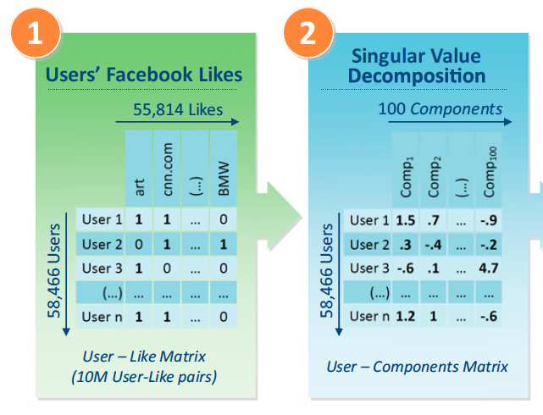
Prediction with Facebook likes

Slide 30
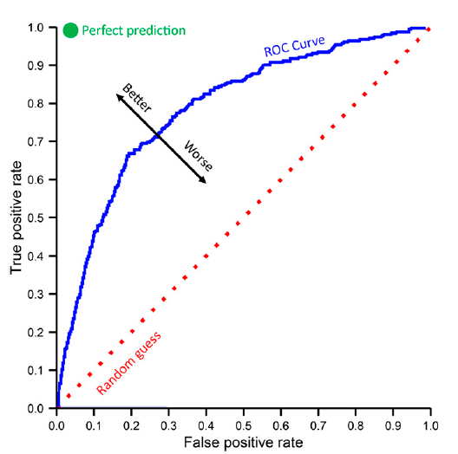
ROC Curve

Slide 31
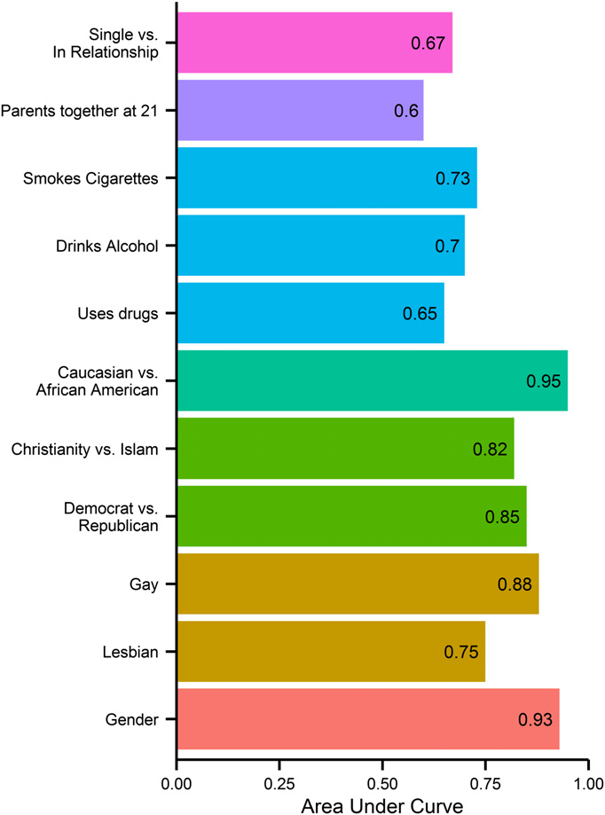
Classification accuracy for binary personal attributes

Slide 32
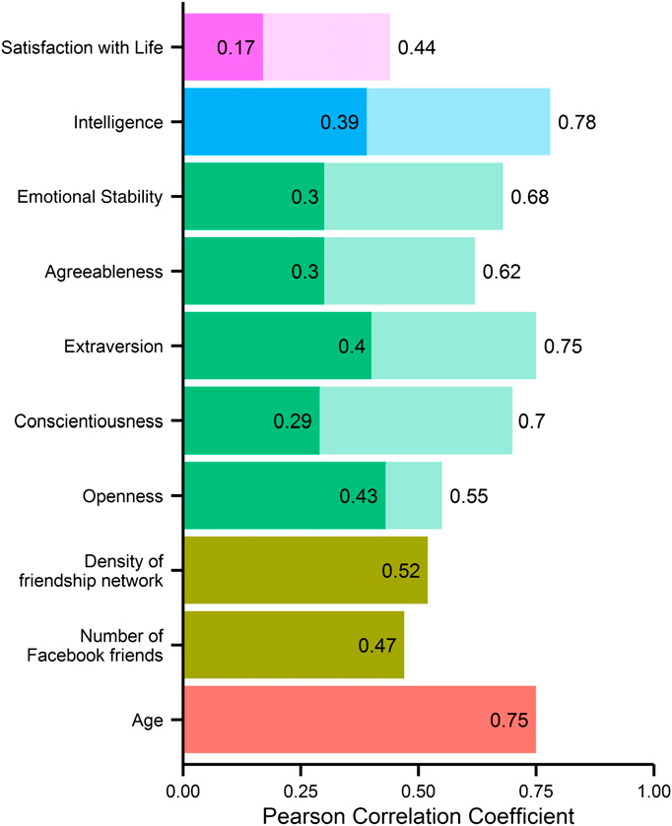
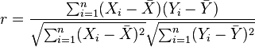
Accuracy of regression for numeric attributes
Pearson Correlation Coefficient r
Notes:
The transparent bars indicate the questionnaire’s baseline accuracy, expressed in terms of test–retest reliability

Slide 33
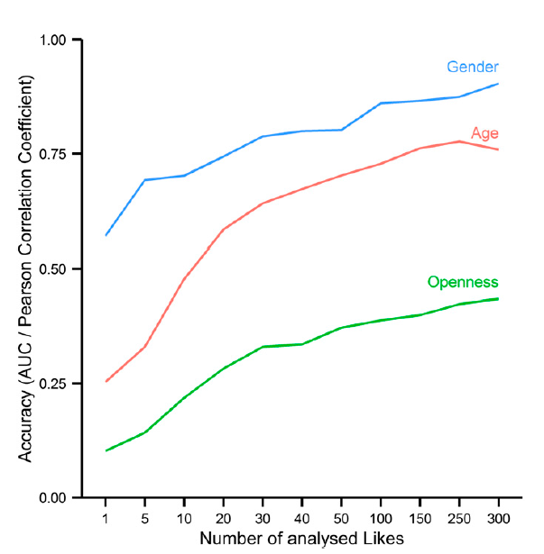
Prediction accuracy vs volume of data (#likes)
Notes:
They said that psychological traits are latent traits (i.e., traits that cannot be measured directly) and they used questionnaire. I believe if user’s Facebook posts were available, they could apply LSA to learn about latent traits somehow. At the high level, they did the following:

Slide 34
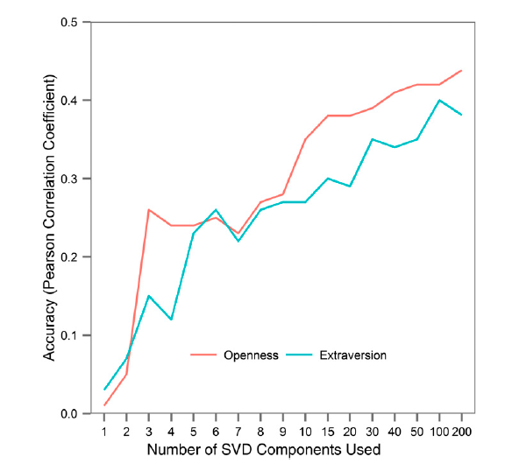
Prediction accuracy vs #SVD components

Slide 35
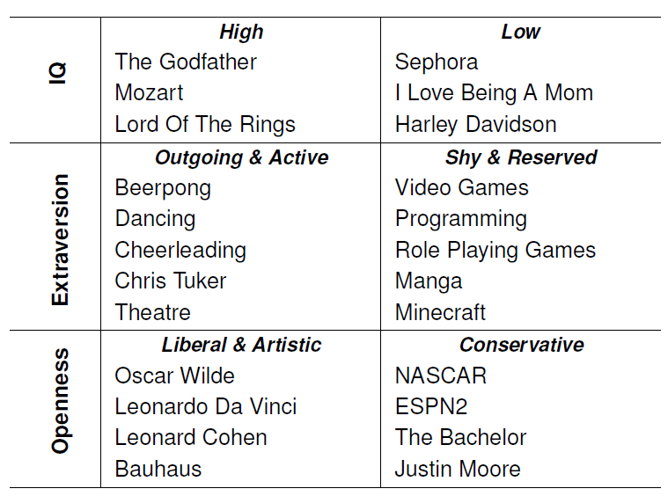
Most predictive likes

Slide 36
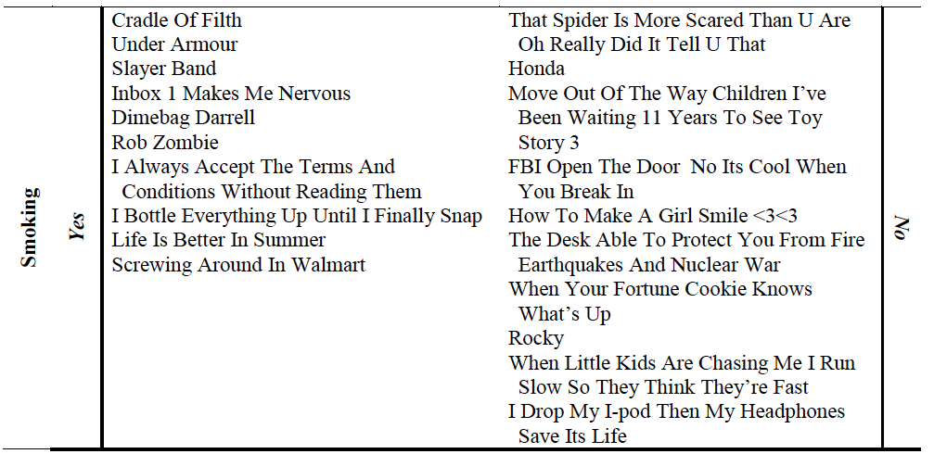

Slide 37
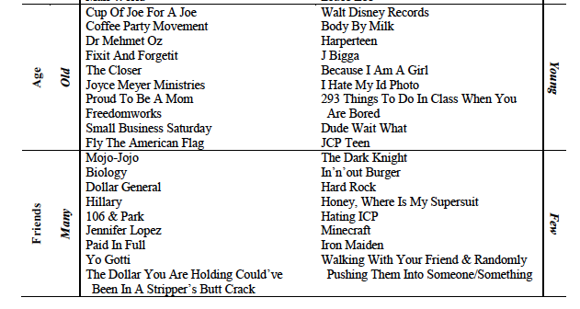

Slide 38
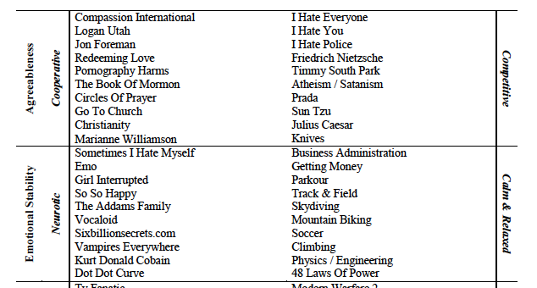

Slide 39
Conclusions
Many private attributes can be inferred from people’s publicly accessible activity, such as Facebook likes
Some attributes are remarkably easy to predict… even a single like can lead to significant improvement over random prediction
This can have benefits, but also risks with respect to privacy

Slide 40
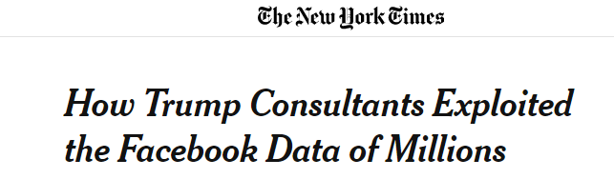
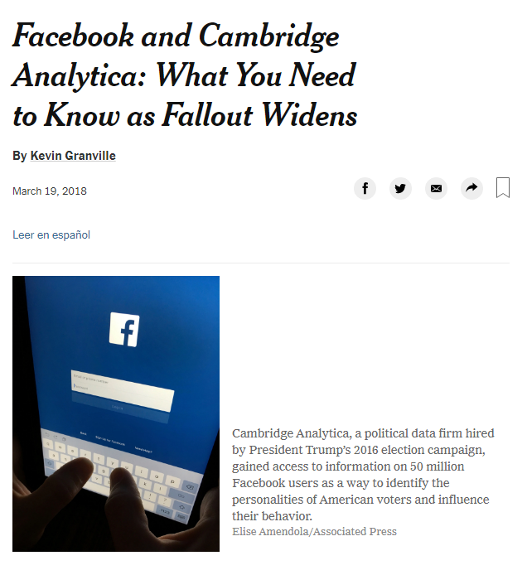
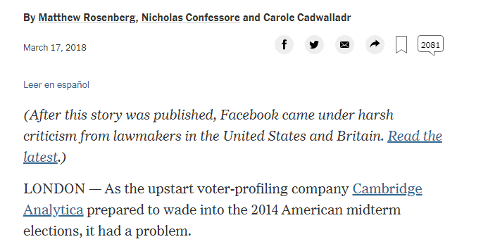
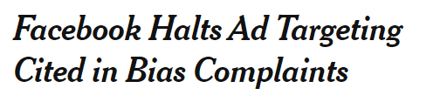
By Noam Scheiber and Mike Isaac March 19, 2019
After years of criticism, Facebook announced on Tuesday that it would stop allowing advertisers in key categories to show their messages only to people of a certain race, gender or age group.
The company said that anyone advertising housing, jobs or credit — three areas where federal law prohibits discrimination in ads — would no longer have the option of explicitly aiming ads at people on the basis of those characteristics.

Slide 41
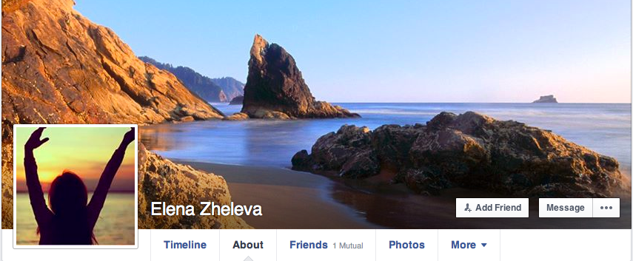
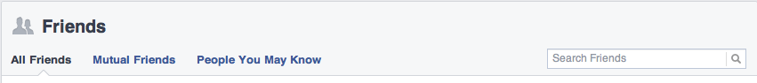
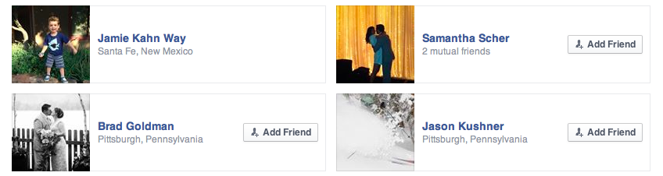
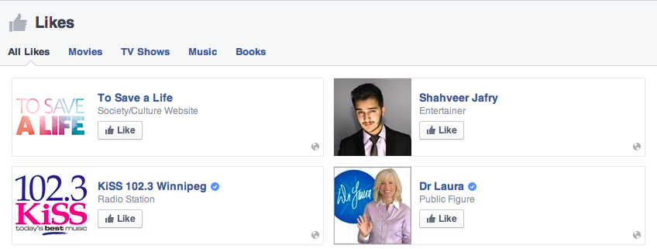
Privacy in social networks
Alice Smith
Social links
Group
affiliations
[slides courtesy of Elena Zheleva]
Notes:
To motivate my work, I am showing a hypothetical user profile on Facebook, the most popular online social network with over 1 billion active users daily.
Through these profiles, users submit a lot of personal information. On some people’s profiles, we can see their gender, where they live, what their religious and political views are. (CLICK) We can also see a list of people they have befriended on facebook. (CLICK) Besides the personal attributes and online friendships, user profiles on social networks often show affiliations to other types of objects, such as pages, groups, and events. (CLICK)
On Facebook alone, there are over 1 billion such objects. Some of these objects are businesses and products and show user preferences explicitly. In addition, there are 8 billion pieces of content shared every day.
On average, a user is connected to 80 community pages, groups and events.
Average user creates 90 pieces of content each month
More than 30 billion pieces of content (web links, news stories, blog posts, notes, photo albums, etc.) shared each month.
(CLICK)

Slide 42
Group affiliations often cannot be hidden!
Hypothesis: you can predict private attributes based on public information
Assumptions:
An online social network with public AND private profiles
Social links and group affiliations are always public
Adversary’s goal: to predict attributes in private profiles
Adversary can build probabilistic models using public data
Private Profile
Alice Smith
Public Profile
Private Profile
Social links
Private Profile
Public Profile
Group
affiliations
Notes:
Privacy settings on social media allow you to customize the content you share with different sets of people. For example, on Facebook, you can choose to have a public profile or to share it only with your friends. At the time of our study, Facebook didn’t allow users to set Page likes to private.
A private profile is one where personal attributes, such as age, gender, political views, location are either not available or viewable by friends only

Slide 43








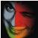
From networks to graphs
Social network Affiliation network
w/ friendship links w/ group links
Large, high-dimensional
Multi-modal
Multi-relational
Alice
David
Willie Nelson
Emily
Glen
Rose Bowl
Billy
Bossa nova
Chris
Fabio
I love 
Matrix
Notes:
Explain what is complex networks – multimodal (nature of the nodes), multi-relational (nature of the links), dimensionality of space, size of network,
“We all know that people who are close to each other in a social network are similar in many ways: they share characteristics, act in similar ways, and participate in similar events”

Slide 44
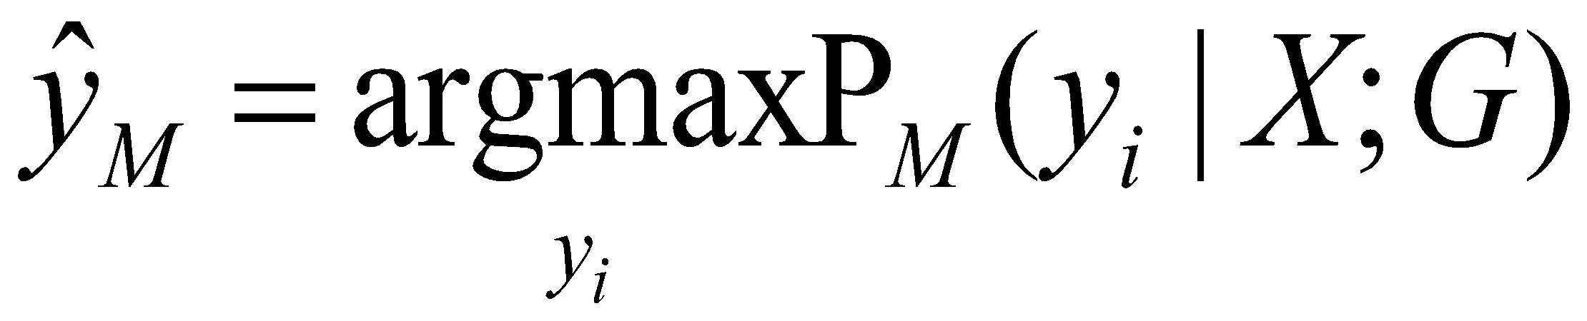
Sensitive attribute disclosure
If an adversary is able to determine the value of a user attribute that the user intended to stay private
private profile
public profile
Y1
Willie Nelson
Y1=?
X1=Male
X1
private profile
public profile
private profile
Rose Bowl
Y2
Y2=?
Y4=?
Bossa nova
X2=Female
X2
public profile
X3=Male
Y3=?
X3
I love 
private profile
Y3
Matrix
Y4
Notes:
To illustrate… Private profiles and attributes – unknown variable values.
Adversary may be trying to predict someone’s gender. We assume that this is a sensitive attribute for people with private profiles
Jointly -> if we know that

Slide 45



Collective classification*
Given a set of trait labels (e.g., liberal or not), label the other objects in the network accurately
Is
liberal?
No links
Traditional ML: independent traits
Social links
Friends <-> common trait
Gender | Location | Liberal
Male | DC | Yes
Female | DC | ?
Alice
David
Interest group links
Affiliation <-> common trait
Latent links
Trait due to common unobserved factor
Liberal parents
Willie Nelson
*Collective Classification in Network Data. Sen et al. AI Magazine 2008.
Notes:
We all know that people who are close to each other in a social network are similar in many ways: they share characteristics, act in similar ways, and participate in similar events
Central to SNA is the idea of homophily which is commonly known as (individual quantitatively by looking at the individual’s social environment, rather than in isolation
Give “liberal” vs. “conservative” example
As you can imagine this inference becomes a lot harder when you add multiple relationships and affiliations and there is uncertainty associated with each link and affiliation. Some people who like Willie Nelson will be liberal, some people will not be liberal.
A lot of

Slide 46
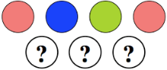
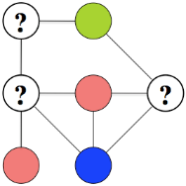
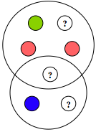
Collective classification
Assume adversary can apply a probabilistic model M to predict the sensitive attribute
No links: BASIC
Majority label
Social links: AGG, CC, BLOCK, LINK
Feature space size: number of users
Group links: CLIQUE, GROUP, GROUP*
Feature space size: number of groups
Both link types: LINK-GROUP
Feature space size: number of users and groups
+
[Zheleva, Getoor. (2009) To Join or not to Join: the Illusion of Privacy in Social Networks with Mixed Public and Private User Profiles. In WWW.]
Notes:
USE links as features
USE links to model explicit statistical dependencies between node labels

Slide 47
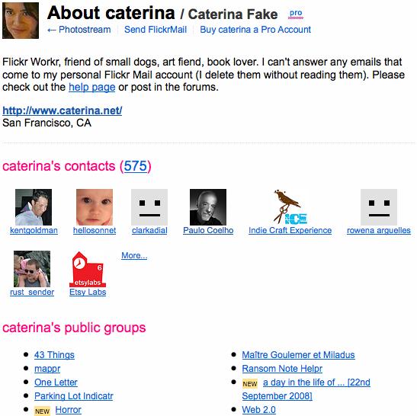

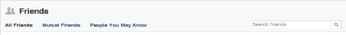
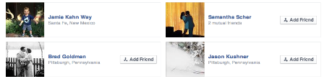
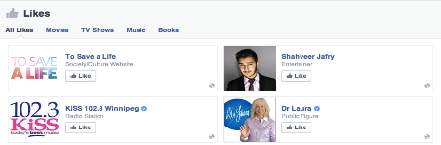
Data and experimental setup
Flickr: snowball sample
~9,000 profiles, 1 million links, 50,000 groups
sensitive: location (55 values)
Facebook: all freshmen (Harvard)
~1,600 profiles, 86,000 links, 3,000 groups
sensitive: gender (2) and political views (6)
Assign each profile to be public with probability=50%
Train model on public profile data (10 different models)
Predict on private profiles
Alice Smith
Notes:
SHOULD BE AT 23 minutes
Explain the groups in each dataset
Explain

Slide 48
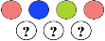

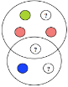
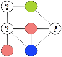
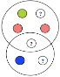

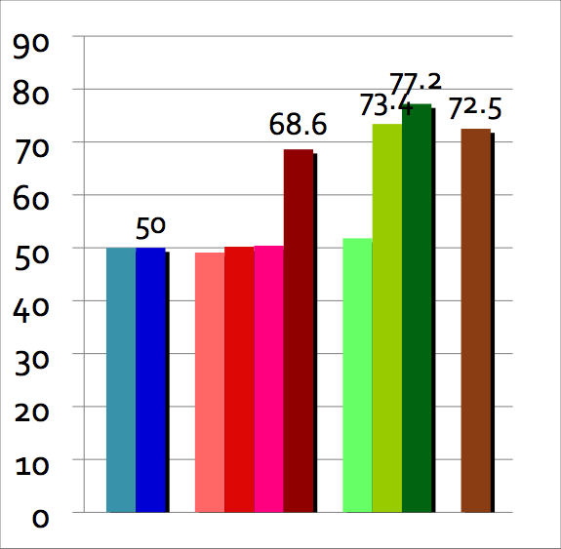
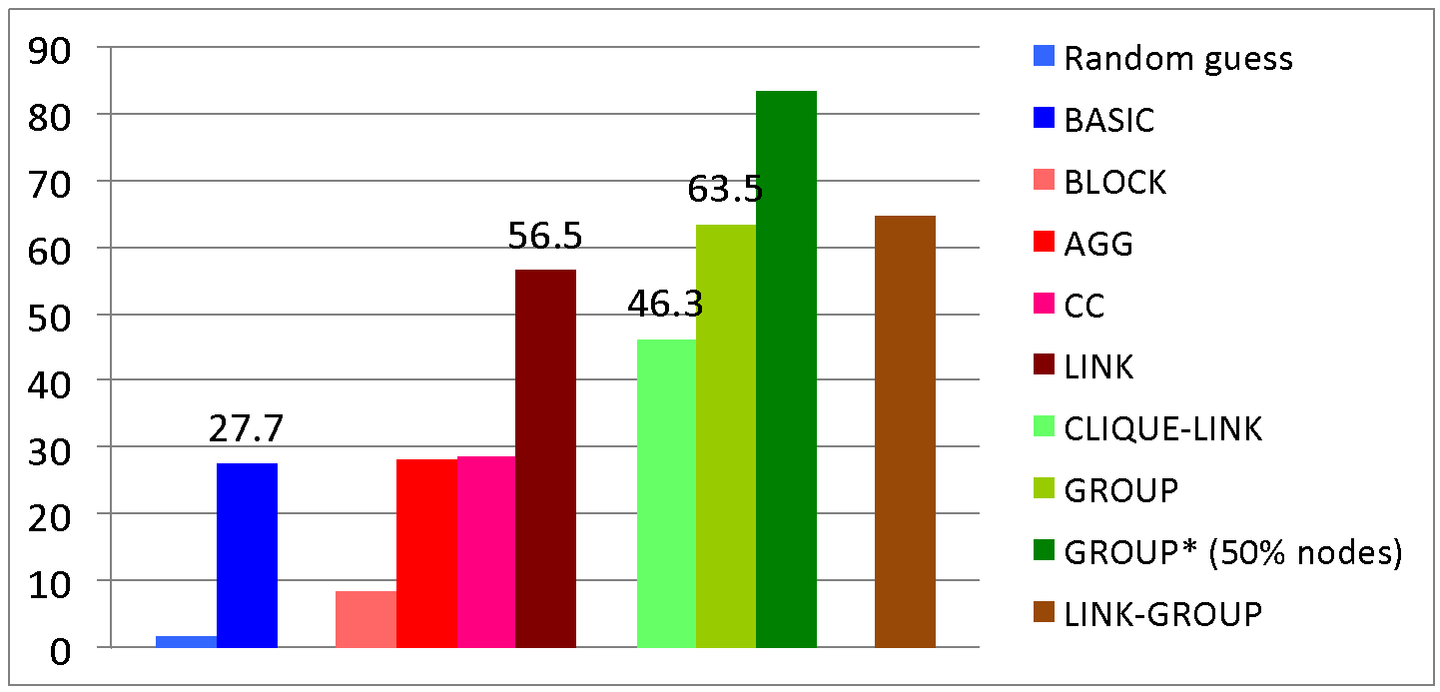
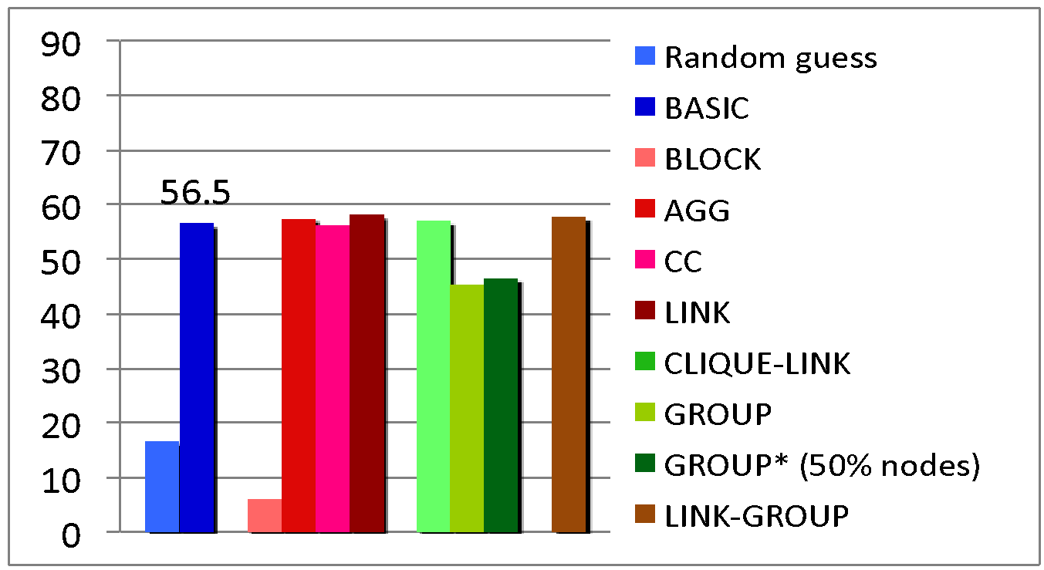
Findings
83.6
Affiliation networks have a high potential for leaking private information
More informative than friendship network
Homogeneous groups most informative
64.8
Country
Gender Political views
Notes:
We used 4 different types of models…. Describe
Affiliation networks boost classification accuracy the most.

Slide 49
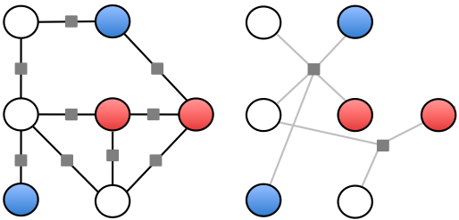
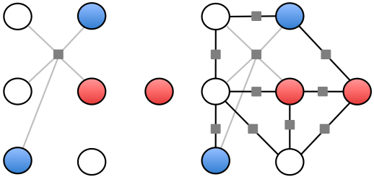
Increasing model complexity
Predict “gender” in the Facebook dataset
Links as structural statistical dependencies
Links as features
Features | LR | pMRF | hoMRF-AG | hoMRF-SG | hoMRF-SG-AL
Social links | 64.06% | 64.31% | 69.13% | 69.22% | 69.22%
Groups | 71.67% | 71.83% | 69.80% | 74.12% | 74.53%
Both | 75.75% | 75.84% | 69.63% | 77.39% | 78.37%
[Zheleva, Getoor, Sarawagi (2010) Higher-order Graphical Models for Classification in Social and Affiliation Networks. NIPS Workshop on Networks Across Disciplines.]
Notes:
Understanding affiliation networks and their interplay with social networks is a key to providing better services online. There are many ways of modeling the data,
Four different ways to represent the same underlying data. How you construct your statistical model can give you very different predictive accuracy. Coming up with the right model to

Slide 50
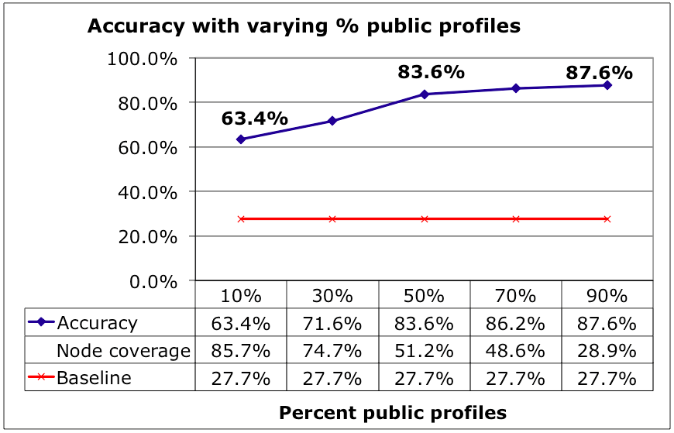
Your privacy depends on others
Higher % public profiles -> higher accuracy

Slide 51

Your privacy depends on others
Higher % public profiles -> higher accuracy

Slide 52
Main takeaways
Increasingly challenging to manage personal information online
Probabilistic models can infer hidden information and circumvent privacy preferences of users
Groups are most significant carriers of private information
For privacy-concerned users
If possible, set group and friendship lists as private
For social media businesses
Enable greater user control over release of information
For policy makers
Set standards for personal data release practices

Slide 53

https://hbr.org/2018/07/want-less-biased-decisions-use-algorithms

Slide 54

At the heart of this work is the concern that algorithms are often opaque, biased, and unaccountable tools being wielded in the interests of institutional power. So how worried should we be about the modern ascendance of algorithms?

Slide 55

There is a pattern among these critics, which is that they rarely ask how well the systems they analyze would operate without algorithms. And that is the most relevant question for practitioners and policy makers: How do the bias and performance of algorithms compare with the status quo?

Slide 56


Slide 57



Slide 58


Slide 59
In the context of New York City pre-trial bail hearings, a team of prominent computer scientists and economists determined that algorithms have the potential to achieve significantly more-equitable decisions than the judges who currently make bail decisions, with “jailing rate reductions [of] up to 41.9% with no increase in crime rates.” They also found that in their model “all categories of crime, including violent crimes, show reductions [in jailing rates]; and these gains can be achieved while simultaneously reducing racial disparities.”

Slide 60
In each of these case studies, the data scientists did what sounds like an alarming thing: They trained their algorithms on past data that is surely biased by historical prejudices. So what’s going on here? How is it that in so many different areas — credit applications, job screenings, criminal justice, public resource allocations, and corporate governance — algorithms can be reducing bias, when we have been told by many commentators that algorithms should be doing the opposite?

Slide 61
In all the examples mentioned above, the humans who used to make decisions were so remarkably bad that replacing them with algorithms both increased accuracy and reduced institutional biases. This is what economists call a Pareto improvement, where one policy beats out the alternative on every outcome we care about. While many critics like to imply that modern organizations pursue the operational efficiency and greater productivity at the expense of equity and fairness, all available evidence in these contexts suggests that there is no such trade-off: Algorithms deliver more-efficient and more-equitable outcomes. If anything should alarm you, it should be the fact that so many important decisions are being made by human beings who we know are inconsistent, biased, and phenomenally bad decision makers.

Slide 62
Of course, we should be doing all we can to eradicate institutional bias and its pernicious influence on decision-making algorithms. Critiques of algorithmic decision making have spawned a rich new wave of research in machine learning that takes more seriously the social and political consequences of algorithms. There are novel techniques emerging in statistics and machine learning that are designed specifically to address the concerns around algorithmic discrimination. [..] This work will likely become even more important as less-transparent algorithms like deep learning become more common.

Slide 63
“This is not an argument for algorithmic absolutism or blind faith in the power of statistics.”
“So the next time you read a headline about the perils of algorithmic bias, remember to look in the mirror and recall that the perils of human bias are likely even worse.”

